Slide 1
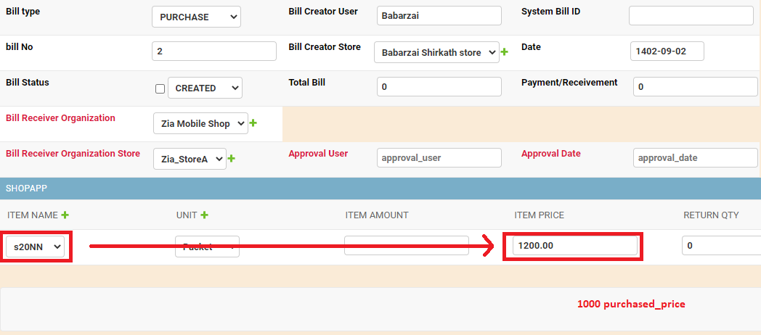

Slide 2
Product amount automat

Slide 3
A16 په سستم کی شته ایا
A16 OPPO LCD یو شای دی
Y20 VIVO LCD او Y20 VIVO LCD (U21 VIVO)
J530 IC FULL ?? J530 IC LCD
J530 IC LCD(Khurasan chin 770) او J530 IC FULL(800) (5768) ما یو حساب کړی ځکه نرخ یی یو دی
Bill No 18447 KCH A810 ORIGINAL LCD ??? Ya ??? A8 205 900Afg
Problem of Total bill 46190.00000 in 18447 bill no
Bill_no 73844 FRM china mic ??? Ya ??? Chiue mic

Slide 4
Billno 43699 A51 icw name ??? Saved in system
Bill 50490 lul څه شی دی دا باید اپډیټ شی
J6 touch category should be touch
J108 W1 J115+ Bi9 24 items name category ????
in Bill NO 14252 wardak J3&J5 OLED LCD came 3 3 2 total 8 so I have written totally instead of individualy
18447 bill kc mushkil
A260 in bill 5839 Maulana have saved by name A260 original LCD because price is same
In bill 5839 incell should be asked whether it is. A21S or A215
J2 cucell
Incell or cucell

Slide 5
Bill 46657 has 335 baqi and kahatha shoo
Bill 71280 it is 2100(2X1050 of M30) + 375(5X75 of Fuji) +1050(unknown I think it may be another M30) =3525
Bill No 5645 :
A22 3x450 = actualy 1350 but in bill it shows 1300
Bill No 53788: Afghan Chine the bill does not have (KAHATHA SHOO) but I write payment

